Slide 1
The Human Resources (HR) Schema
DEPARTMENTS
department_id
department_name
manager_id
location_id
LOCATIONS
location_id
street_address
postal_code
city
state_province
country_id
JOB_HISTORY employee_id
start_date
end_date
job_id
department_id
EMPLOYEES
employee_id
first_name
last_name
email
phone_number
hire_date
job_id
salary
commission_pct
manager_id
department_id
COUNTRIES
country_id
country_name
region_id
JOBS job_id
job_title
min_salary
max_salary
REGIONS
region_id
region_name
Notes:
The Human Resources (HR)Schema Description
The Human Resources (HR) schema is a part of the Oracle Sample Schemas that can be installed in an Oracle database. The practice sessions in this course use data from the HR schema.
Table Descriptions
REGIONS contains rows that represent a region such as America, Asia, and so on.
COUNTRIES contains rows for countries, each of which is associated with a region.
LOCATIONS contains the specific address of a specific office, warehouse, or production site of a company in a particular country.
DEPARTMENTS shows details about the departments in which the employees work. Each department may have a relationship representing the department manager in the EMPLOYEES table.
EMPLOYEES contains details about each employee working for a department. Some employees may not be assigned to any department.
JOBS contains the job types that can be held by each employee.
JOB_HISTORY contains the job history of the employees. If an employee changes departments within a job or changes jobs within a department, then a new row is inserted into this table with the earlier job information of the employee.

Slide 2
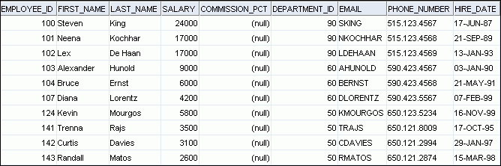
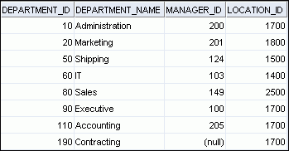
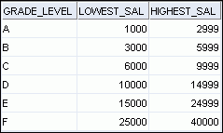
EMPLOYEES
JOB_GRADES
DEPARTMENTS
Notes:
Tables Used in the Course
The following main tables are used in this course:
EMPLOYEES table: Gives details of all the employees
DEPARTMENTS table: Gives details of all the departments
JOB_GRADES table: Gives details of salaries for various grades
Apart from these tables, you will also use the other tables listed in the previous slide such as the LOCATIONS and the JOB_HISTORY table.
Note: The structure and data for all the tables are provided in Appendix B.

